Slide 1

An IoT based smart device for the visually impaired
DRISHTI

Slide 2
Introduction
Many people suffer from serious visual impairments preventing them from travelling independently. Accordingly, they need to use a wide range of tools and techniques to help them in their mobility. The increasing number of blind persons attracts the development of many assistive devices around the world. The current estimates predict that there are 40 million blind people in the world majority of whom use a simple stick for navigation in their everyday life.
We, in an effort to help this people have come up with an idea of replacing with advanced iot enabled shoes to make the life of blind people much more easier.

Slide 3
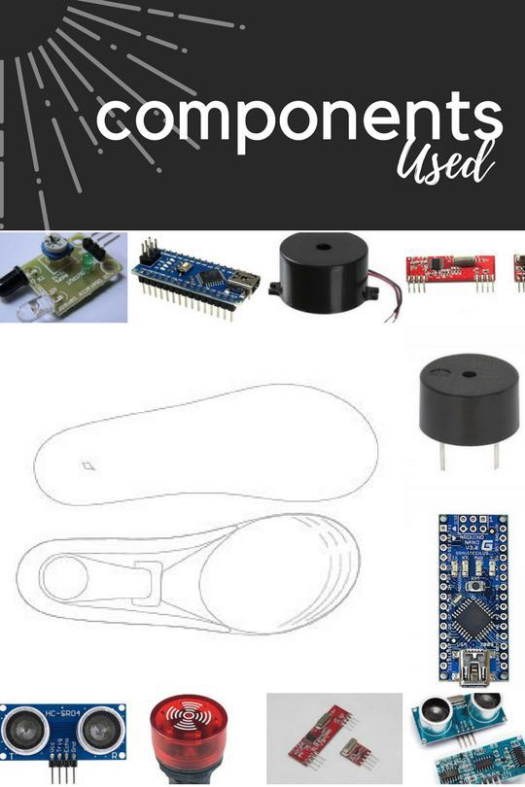

Slide 4
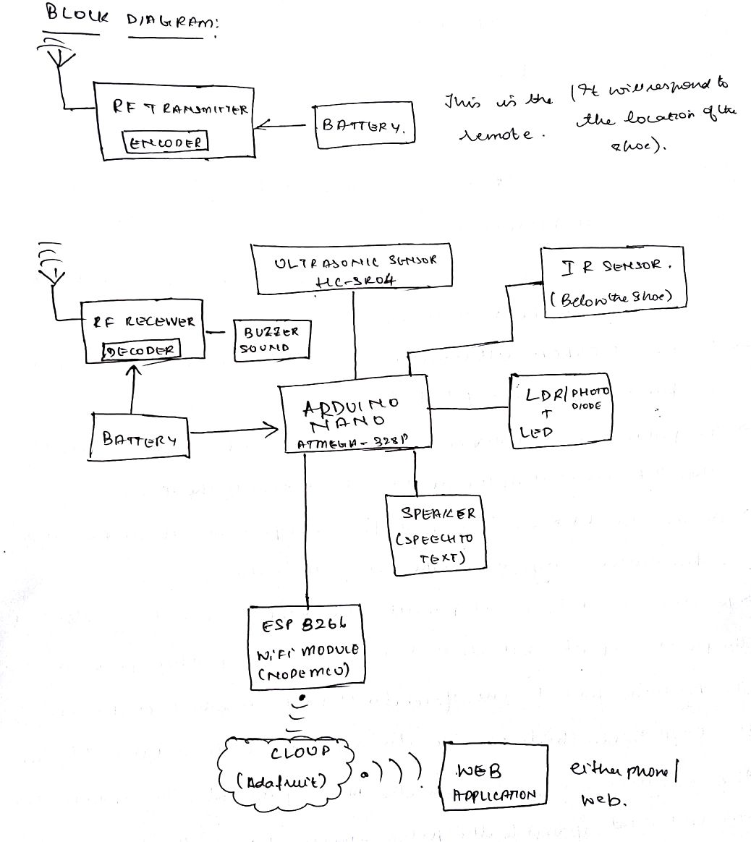

Slide 5
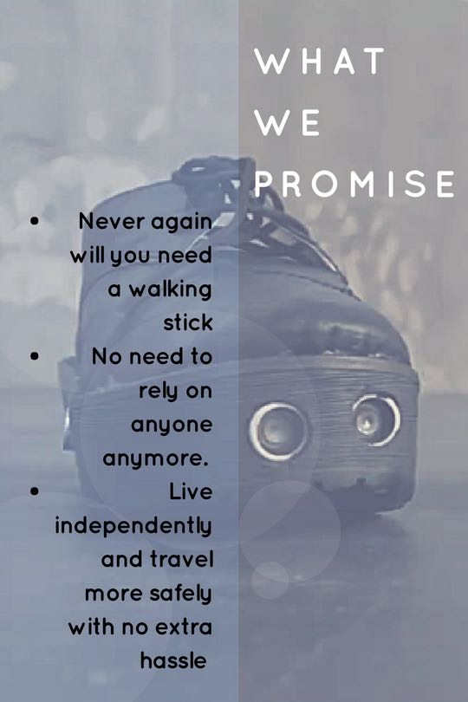
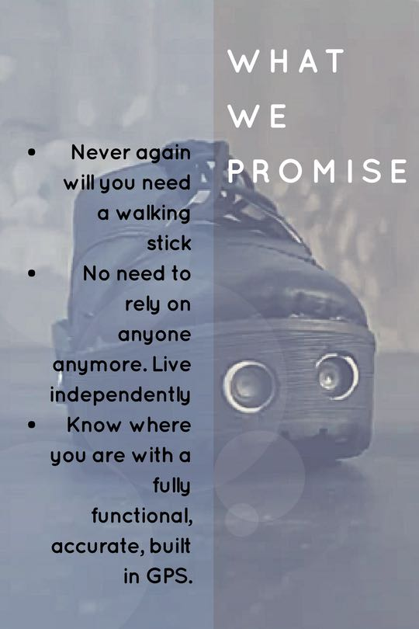

Slide 7
